Slide 1






[Work Balance AI – Intelligent Faculty Load Optimizer]
PRESENTATION 2026
Dr. Shruti Tiwari
tiwarishruti1@gmail.com
Faculty Name
abc@xyz.com
Uma Maheshwari
Guide Name

Slide 2

Outline
Abstract of the Project
Problem Statement
Proposed Solution
System Architecture
Live Demo of the Project
Embedded Video of Project
Conclusion
Future Scope

Slide 3
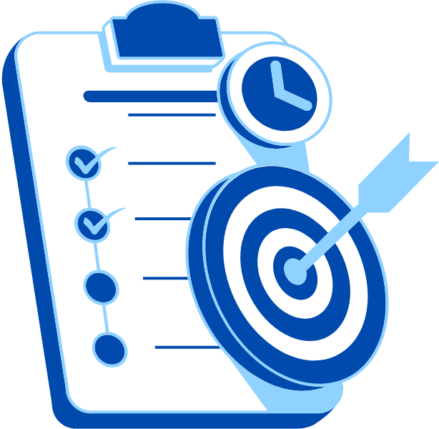
Abstract
Objective: To address faculty workload imbalance in design education (studio critiques, lab setup, portfolio evaluations) using data analytics.
Tools & Technologies: Microsoft Excel (Cleaning, Pivot Tables, SUMIF/COUNTIF) & Microsoft Copilot (AI-assisted insights).
Process: Cleaned raw faculty data (45 records, 5 specializations), analyzed workload patterns, and generated AI summaries.
Key Highlight: Industrial Design faculty showed 40% higher lab setup time. Copilot reduced report generation time from 2 hours to 20 minutes.
Expected Outcome: A replicable, data-driven framework for transparent academic governance aligned with NEP 2020.

Slide 4

Problem Statement
Core Problem: Fragmented, manual tracking of design-specific workload (studio, critiques, lab setup) leading to burnout and poor resource planning.
Significance: Unlike theory programs, design pedagogy requires intensive hands-on contact hours. Without analysis, leaders cannot see imbalances.
Affected Users: Faculty (burnout risk), Students (poor mentorship), HOD/Dean (accreditation risks for NAAC/NIRF).
Limitations of Existing Approaches: Basic spreadsheets with no analytical capability; no AI-assisted reporting; generic systems ignore design-specific tasks (e.g., 3D printer/laser cutter setup).

Slide 5

Proposed Solution
The Solution: An "Intelligent Faculty Load Optimizer" using Excel & Copilot.
Methodology:
1. Collect design-specific data (5 specializations).
2. Clean data (Remove duplicates, handle missing values, standardize names).
3. Analyze using Pivot Tables, SUMIF, COUNTIF.
Generate dashboards & AI summaries via Copilot.
Key Benefits:
1. Design-specific relevance (Captures critiques, lab setup, portfolio evals).
2. AI-powered speed (Automated summaries & redistribution recommendations).
3. Cost-effective (Uses existing Microsoft 365 licenses).

Slide 6
System Architecture
Data Input / Source
Processing / Analysis
Faculty records from Parul Institute of Design (Graphic, Industrial, Fashion, UX/UI, Interior Design). Raw CSV files.
Remove duplicates, standardize categories (e.g., "UX" → "UX/UI"), Pivot Tables, SUMIF for workload totals.
AI / Tool Integration
Output / Dashboard
Microsoft Copilot prompts to generate executive summaries, identify overburdened faculty, and suggest redistribution.
Interactive bar charts (workload by specialization), stacked bar charts (time allocation), and a PDF summary report.

Slide 7
Live Demo of Project
Here's the list of some demo screenshots / features of the project:
Demo 1
Demo 2
Demo 3
Demo Title: Data Cleaning & Standardization
Description: This demo shows the "Before vs. After" of the raw dataset.
Key Features:
Removal of 2 duplicate faculty entries.
Handling of 6 missing values (filled with 0).
Standardization of specializations (e.g., fixing "UX", "UI/UX" to "UX/UI Design").
Result: A clean, analysis-ready dataset of 43 faculty records.
Demo Title: Workload Imbalance Dashboard (Excel Charts)
Description: Visualization of total weekly hours across five design specializations.
Key Features:
Bar chart comparing average workload (Industrial Design: 44 hrs/week vs. Graphic Design: 34 hrs/week).
Heat map highlighting 4 faculty members exceeding 45 hours/week.
Result: Immediate identification that Industrial Design and Fashion Design are overburdened (58% of excess hours).
Demo Title: Microsoft Copilot Integration
Description: Using AI to generate actionable academic policy recommendations.
Key Features:
Prompt: "Summarize workload by specialization and suggest redistribution for the Dean."
AI Output: Identified Lab Setup time as the primary driver of overload in Industrial Design.
Result: Professional, ready-to-submit executive summary generated in under 45 seconds.

Slide 8
Video of Project Demo
[https://your-project-demo-link.com]
▶
[Insert your project demo video.
You can embed a video your live project.]

Slide 9

Conclusion
Accomplishment: Successfully built an AI-powered workload balancer specifically for Parul Institute of Design.
Key Results:
Industrial Design faculty have 40% higher lab setup time.
Copilot reduced reporting time by ~83% (2 hours → 20 min).
Identified 4 "high-risk" faculty members exceeding 45 hrs/week.
Value Added: Provides the Dean/HOD with transparency, supports NAAC documentation, and aligns with NEP 2020 & SDG 4 (Quality Education).
CONCLUSION

Slide 10

Future Scope
Real-time Integration: Connect to Microsoft Forms or Power Automate for weekly faculty check-ins.
Predictive Analytics: Use Excel Forecast Sheet to predict future workload peaks (e.g., pre-accreditation rushes).
Scalability: Expand the framework to other creative disciplines (Architecture, Fine Arts).
Advanced UI: Build a Power Apps interactive dashboard for non-technical users to explore data without touching Excel.
Prompt Library: Develop a standardized prompt library for Copilot specific to design education governance.

Slide 11
Thank You
AICW Fellowship | Student Project Presentation 2026
LinkedIn | Edunet Foundation

